Slide 1
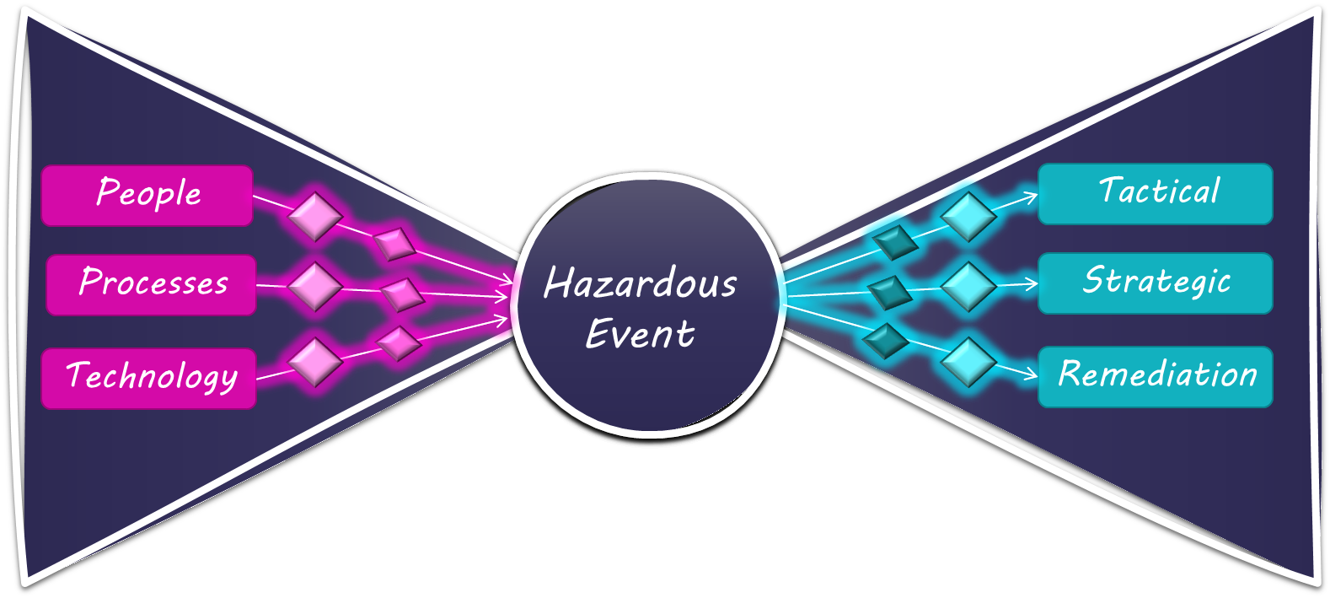
Bowtie Risk Analysis
Noe Compliance
Crystal Noe
“By failing to prepare,
you are preparing to fail.”
–Benjamin Franklin.

Slide 2
Fiat & Crypto Share many things in common, one of those being Risk Management.
Risk Management is the identification, evaluation, and prioritization of risks, followed by coordinated and economical application of resources to minimize, monitor, and control the probability or impact of unfortunate events or to maximize the realization of opportunities.

Slide 3
Risk Bowtie
Prevention
Recovery
Cause
Consequence
Potential Outcomes
Cause
Hazardous
Event
Consequence
Potential Causes
Cause
Consequence
Control Barriers
Control Barriers
Defense Barriers
Before
After

Slide 4
Risk Bowtie
Prevention
Recovery
Prevention
Tactical
Tactical
Tactical
Tactical
Tactical
Tactical
Tactical
People
Tactical
People
People
People
People
People
People
People
Strategic
Strategic
Strategic
Strategic
Strategic
Strategic
Strategic
Processes
Strategic
Processes
Sanctioned
Transaction
Processes
Sanctioned
Transaction
Processes
Processes
Processes
Hazardous
Event
Sanctioned
Transaction
Sanctioned
Transaction
Processes
Sanctioned
Transaction
Processes
Hazardous
Event
Sanctioned
Transaction
Potential Outcomes
Potential Causes
Remediation
Remediation
Remediation
Remediation
Remediation
Remediation
Remediation
Technology
Remediation
Technology
Technology
Technology
Technology
Technology
Technology
Technology
Control Barriers
Control Barriers
Defense Barriers
Before
After

Slide 5
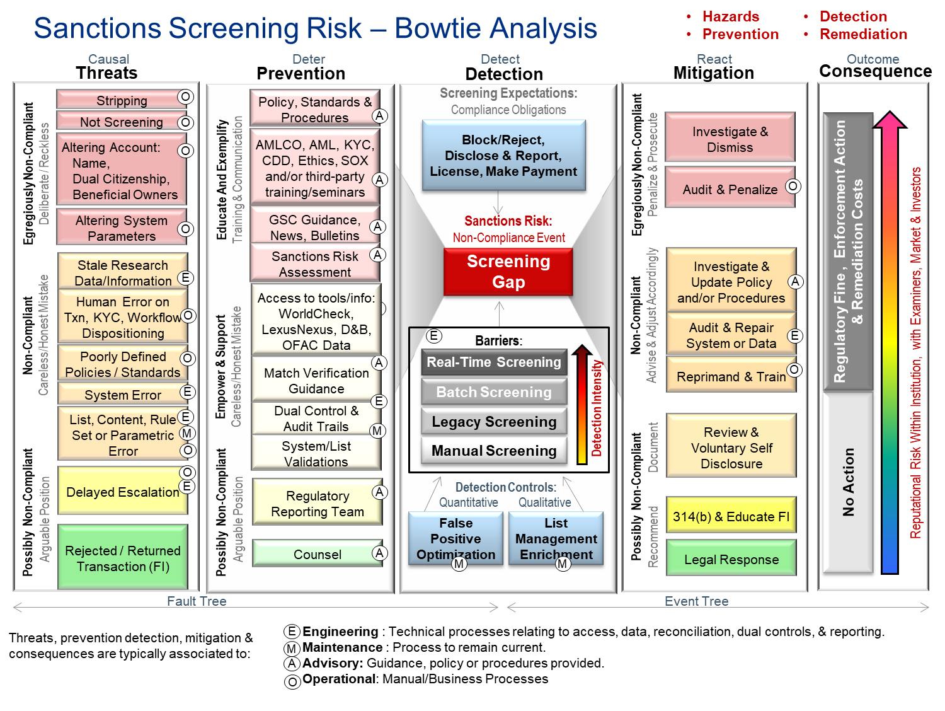
Sample focused on Sanctions Screening
Here is an example of a Risk Bowtie analysis focused on the causes and consequences of a Sanctions Screening gap
This same bowtie can be updated to address Screening Risk for Cryptos as there are many similarities.
By introducing factors such as Mixers, Vendor Limitations
(eg New/Historical chain data), L2 Protocols, MultiSigs, etc
we are able to account for Crypto Causes and Consequences

Slide 6
Mapping Out Causes & Consequences
1.) Identify the “Hazardous Event”, examples:
sanctions non-detection / failure,
defective IP Blocking / Geo-Fencing
defective Transaction Monitoring
Etc.
2.) Identify Causes / Threats
As a starting point, consider brainstorming sessions that focus on People, Processes, & Technology
3.) Map Consequences
For each cause/threat:
identify a preventative control,
detection method(s),
mitigation efforts to reduce exposure, and
consequences.

Slide 7
If you don’t own your risk, It will own you.
https://noecompliance.com

Slide 8
Extras & Old Notes

Slide 9
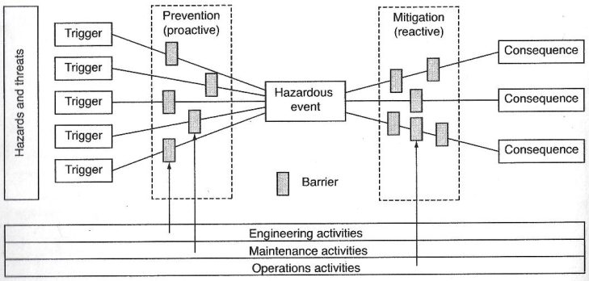
What is a Bow-Tie (BT) Model?
BT’s assess risk by looking at:
Hazards/Threats
The Cause of these Threats
Proactive Prevention
Monitoring/Detection
Reactive Mitigation
Outcome & Consequence
BT combines:
Fault tree analysis
Event Tree Analysis
Causal Charting
Control Thinking

Slide 10
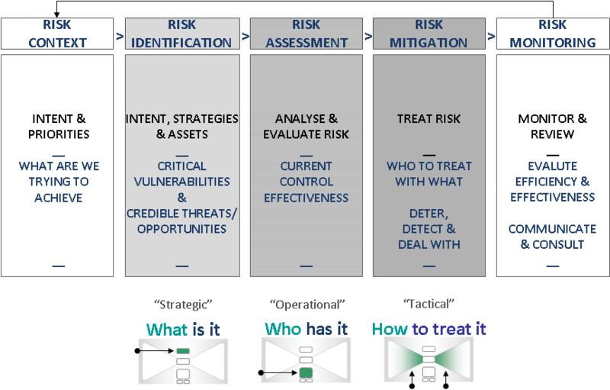

Slide 11
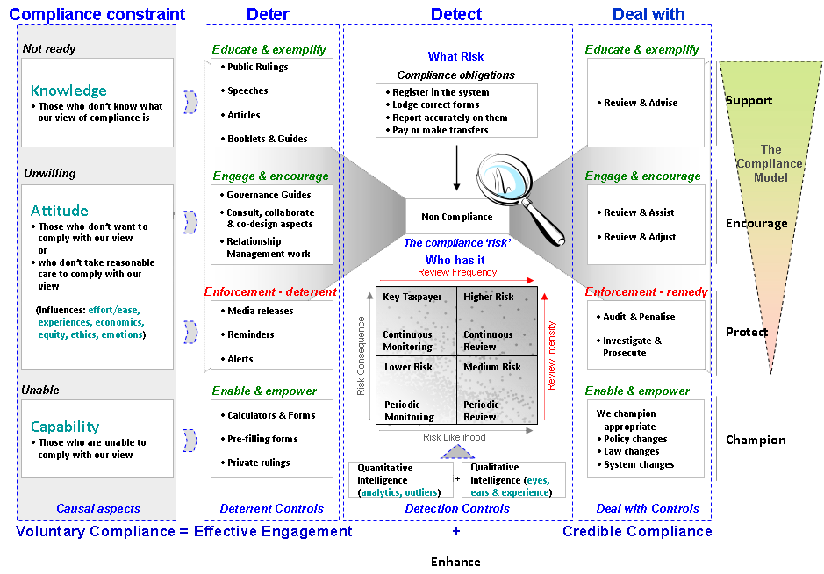

Slide 12
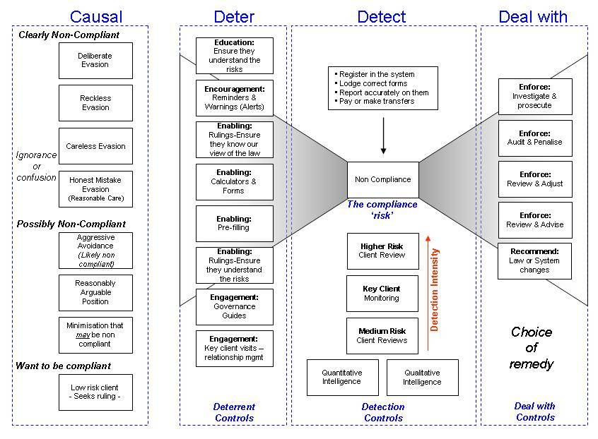

Slide 13
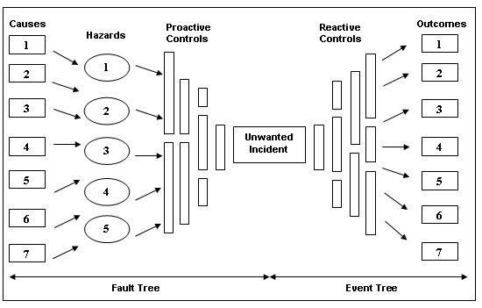

Slide 14
End

